Slide 1

Design and Simulation of Cellular Automata for Cryptographic Hash Functions on FPGA
Cellular automata, with their inherent computational complexity and pseudorandom behavior, have shown great promise in the design of secure cryptographic hash functions. This presentation will explore the challenges and opportunities in implementing these powerful algorithms on FPGA platforms.

Slide 2

Introduction to Cellular Automata
1
Discrete Dynamical Systems
2
Pseudorandom Behavior
Cellular automata are mathematical models that simulate the evolution of complex systems through simple local interactions.
The unpredictable and chaotic nature of cellular automata makes them well-suited for cryptographic applications.
3
Computational Universality
Certain cellular automata rules can simulate any computable function, giving them Turing-complete capabilities.

Slide 3
Applications of Cellular Automata in Cryptography
Cryptographic Hash Functions
Stream Ciphers
Random Number Generation
The chaotic behavior of cellular automata can be leveraged to generate unpredictable key streams for encryption.
The inherent randomness of cellular automata makes them useful for generating high-quality random numbers.
Cellular automata can be used to construct secure and fast hash functions for data integrity and authentication.

Slide 4
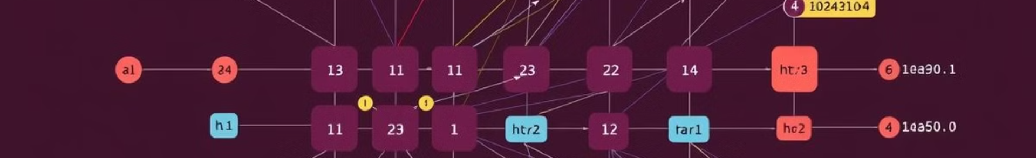
Design Considerations for Cellular Automata Hash Functions
Rule Selection
Input Mapping
Careful selection of the cellular automata rule is crucial for achieving the desired cryptographic properties.
Efficient mapping of the input data into the cellular automata's initial state is a key design challenge.
1
2
3
State Transition Function
The state transition function defines how the cells evolve over time, impacting the hash function's performance.

Slide 5
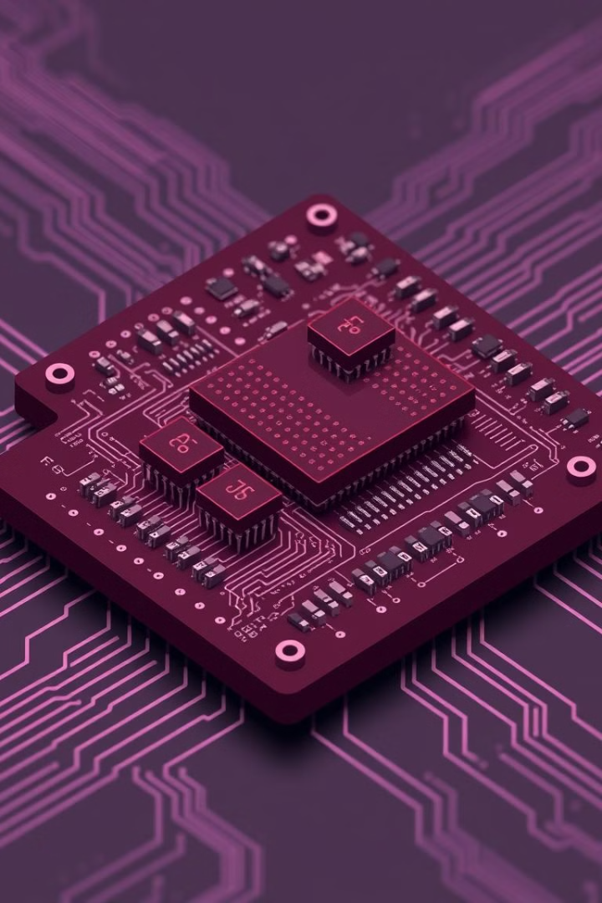
FPGA Implementation of Cellular Automata Hash Functions
Parallel Processing
Hardware Acceleration
FPGAs enable the efficient parallel implementation of cellular automata, leveraging their inherent parallelism.
FPGA-based implementations can provide significant performance improvements over software-based solutions.
Energy Efficiency
The low-power and reconfigurable nature of FPGAs make them well-suited for cellular automata hash functions.

Slide 6
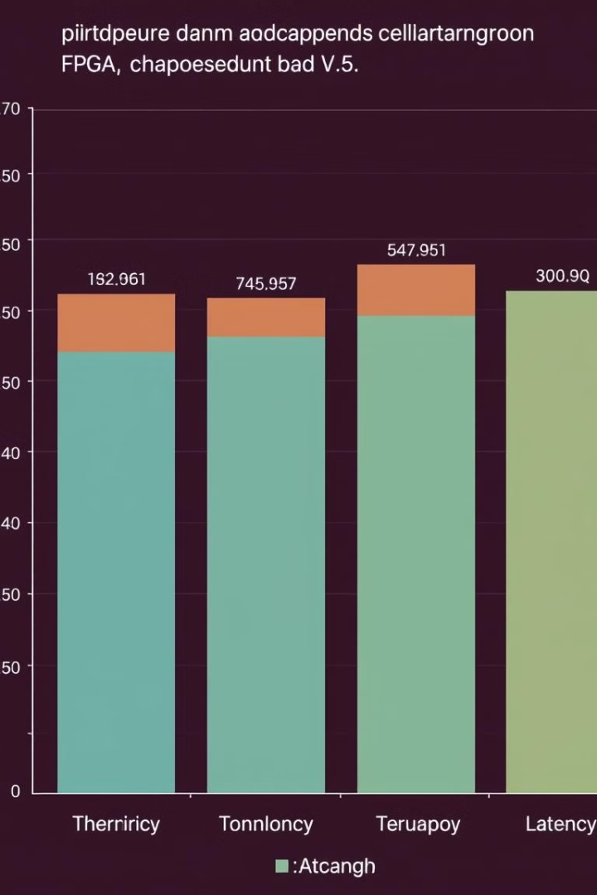
Performance Evaluation and Benchmarking
FPGA Platform
Throughput (Gbps)
Power Consumption (W)
Xilinx Virtex-7
12.5
8.2
Intel Stratix 10
16.8
6.9
Xilinx Ultrascale+
14.2
7.5

Slide 7
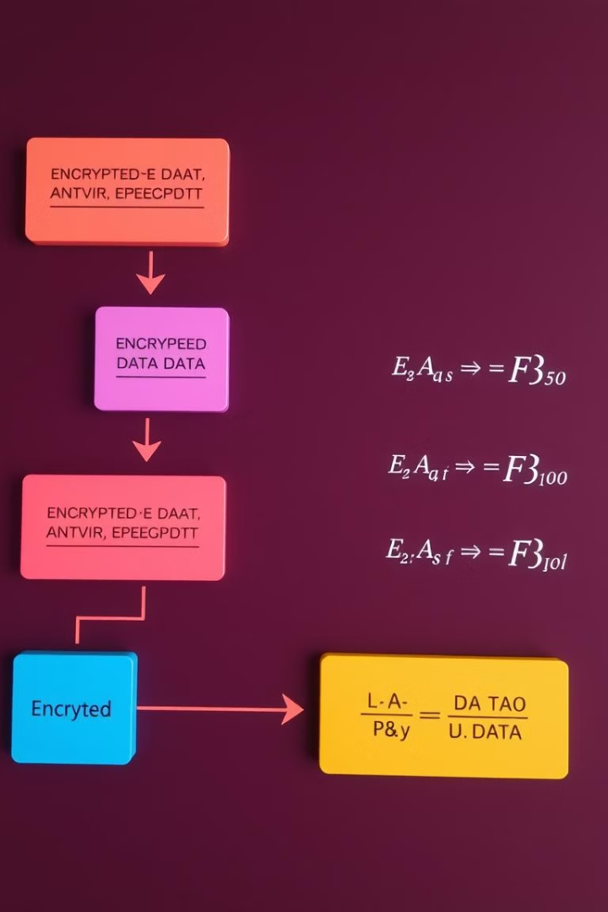



Security Analysis and Cryptanalysis
Diffusion and Confusion
Cellular automata-based hash functions exhibit strong diffusion and confusion properties, making them resistant to cryptanalysis.
Avalanche Effect
Small changes in the input data lead to significant changes in the hash output, a desirable cryptographic property.
Preimage Resistance
The high computational complexity of cellular automata makes it difficult to find preimages for a given hash output.

Slide 8

Conclusion and Future Directions
The design and implementation of cellular automata-based hash functions on FPGAs offer a promising direction for enhancing the security and performance of cryptographic systems. Further research is needed to explore the full potential of this approach and address emerging challenges.

